Slide 1


HackDecó

Slide 2
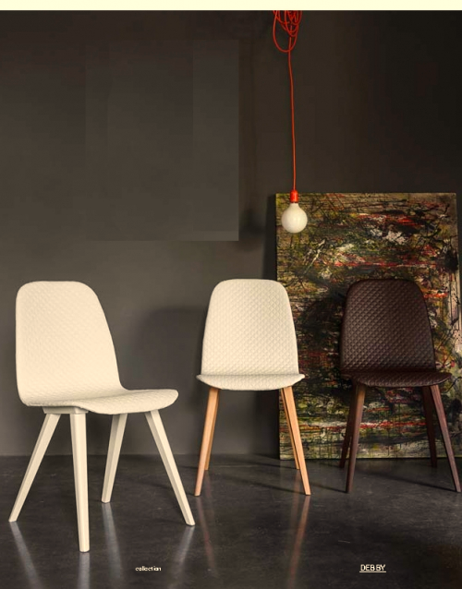

Slide 8
HackDecó

Slide 9
HackDecó

Slide 10
HackDecó

Slide 11
HackDecó
Lounge Chair
Charles & Ray Eames, 1956
8.840 €
Vitra

Slide 12
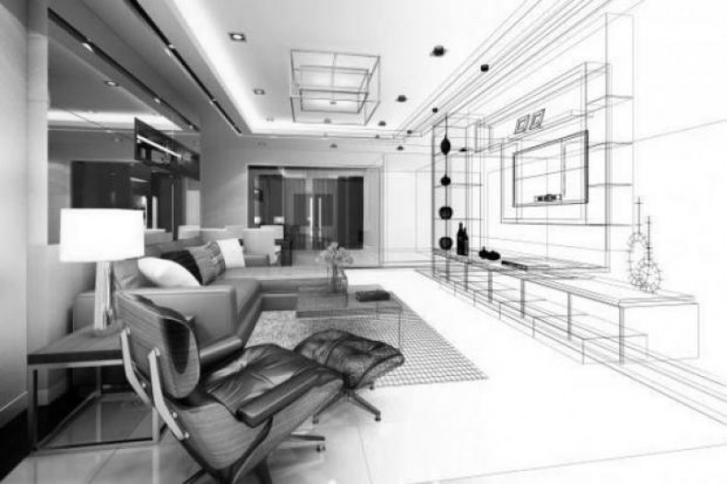

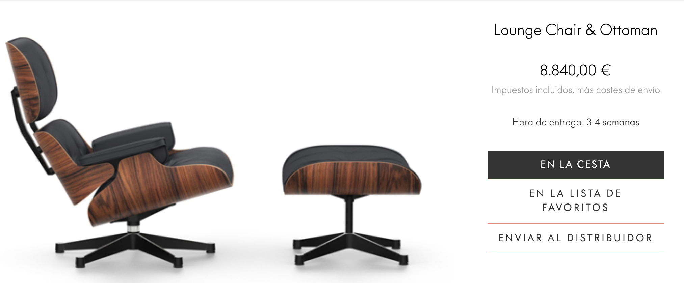
HackDecó
Lounge Chair
Charles & Ray Eames, 1956
8.840 €
Vitra

Slide 13
HackDecó
Year 1956
8.840€

Slide 14

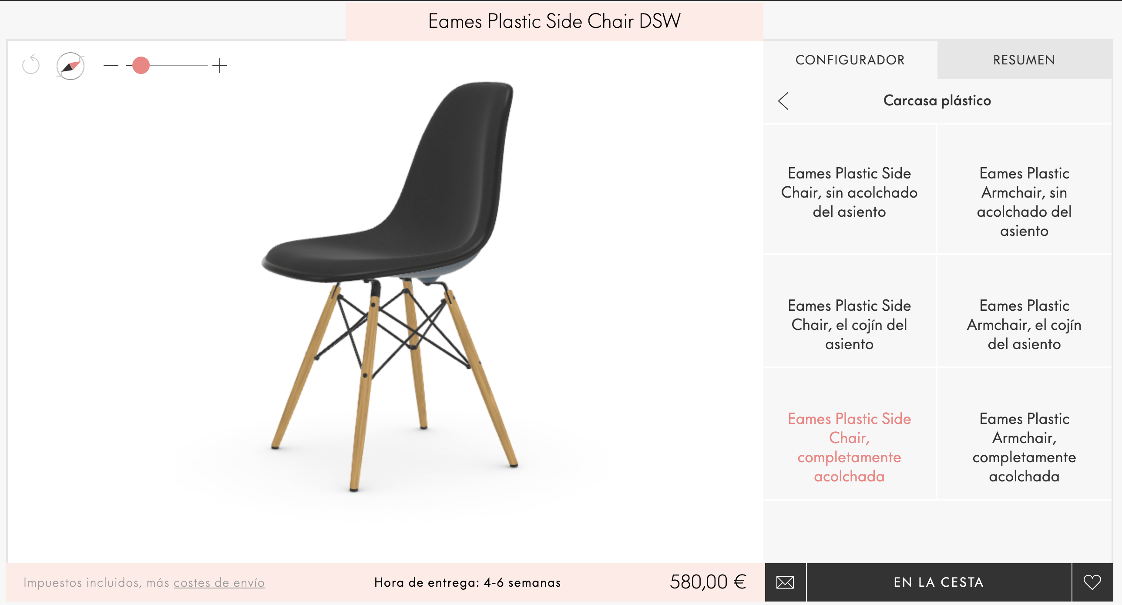
HackDecó
Year 1956
8.840€
549€

Slide 15
HackDecó
Year 1956
8.840,00 €
Year 1950
580,00 €

Slide 16
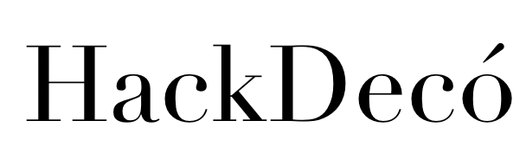
HackDecó
Year 1956
8.840,00 €
Year 1950
580,00 €

Slide 17
HackDecó
Year 1956
8.840,00 €
549,00 €
Year 1950
580,00 €
59,90€

Slide 18
HackDecó
…only this?

Slide 19
HackDecó
Your chidren design…

Slide 20
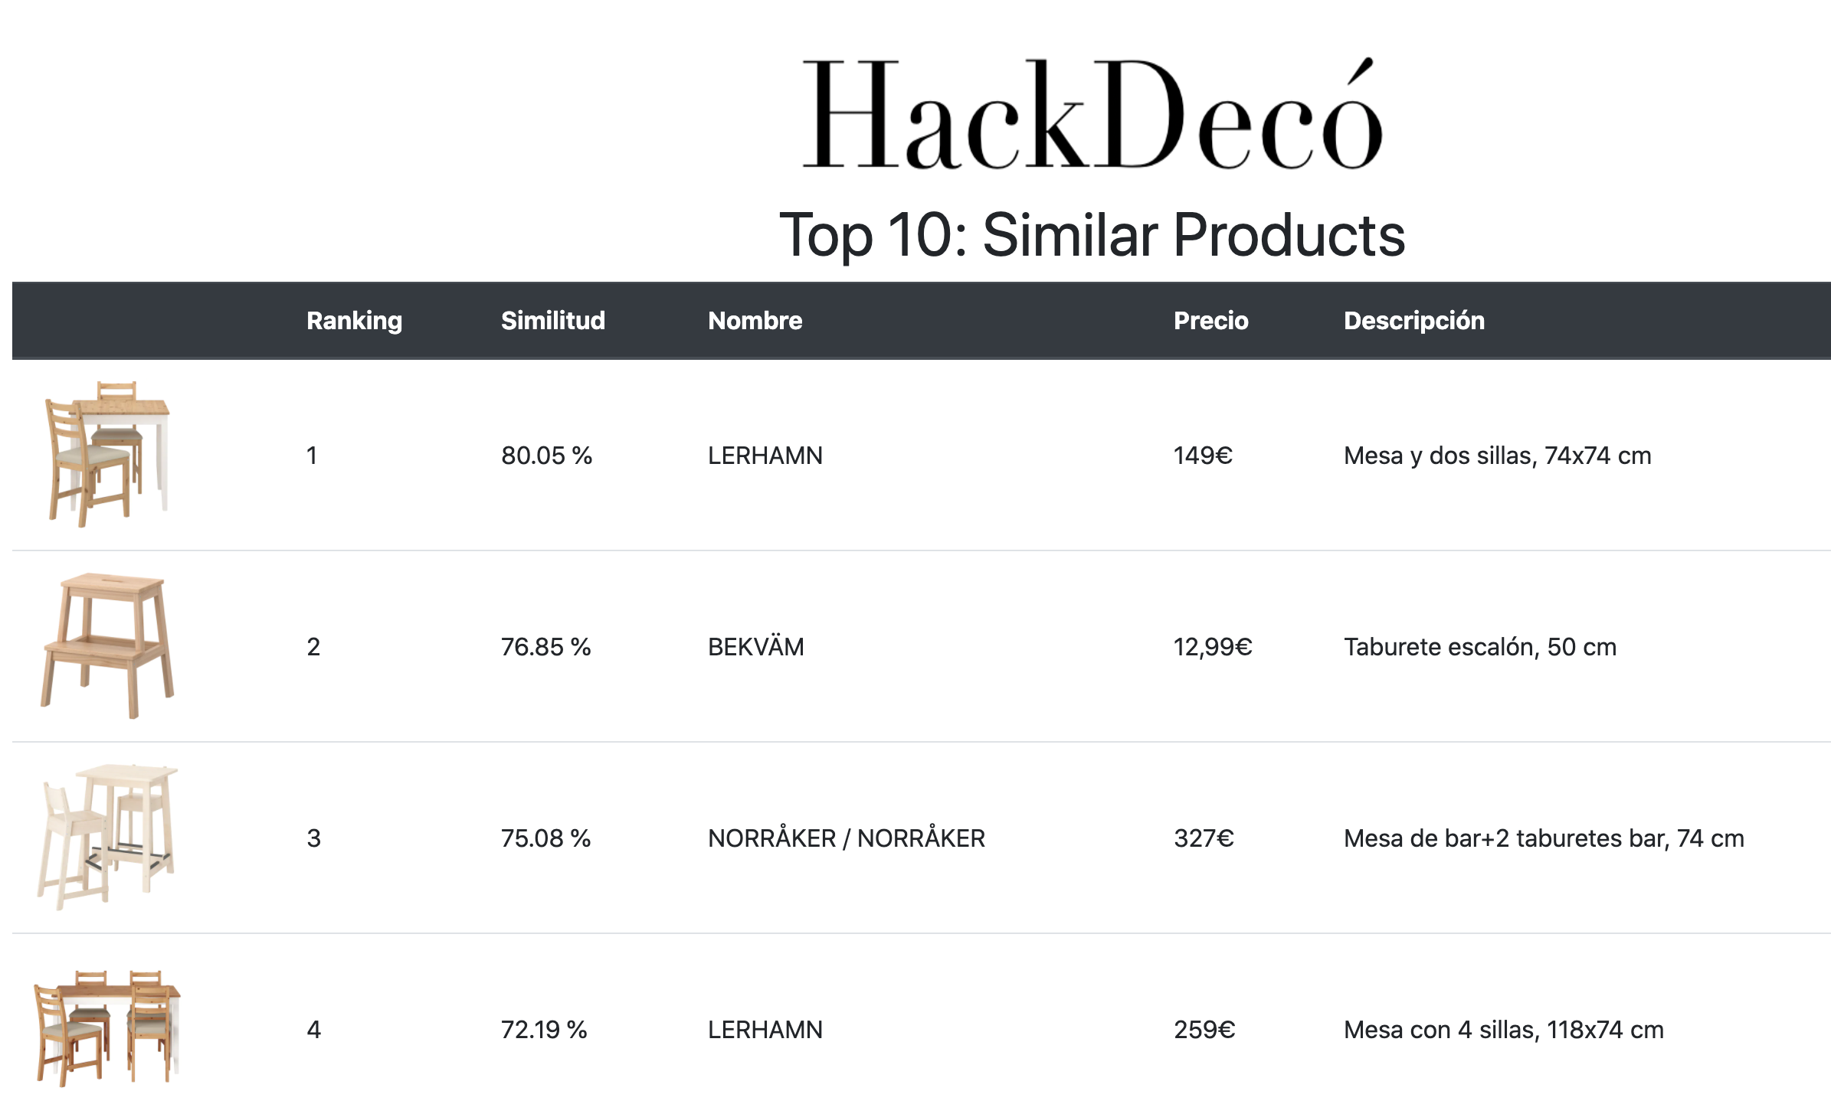
HackDecó
…we will find the most similiars

Slide 21
HackDecó
3 eassy steps:
1.- Take a picture
2.- Select your preferences
3.- Clic “Search”

Slide 22

HackDecó
Webscrapping
Data cleaning
Deep Learning
Web developement
Hosting

Slide 23
HackDecó
Next Steps (ongoing):
Hosting
Image Segmentation:

Slide 24
HackDecó
Thanks for your attention

Slide 25
HackDecó
Thanks for your attention
…haaacking time!!!

